Slide 1
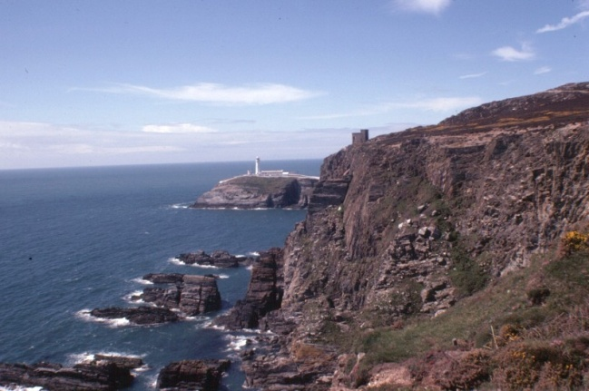
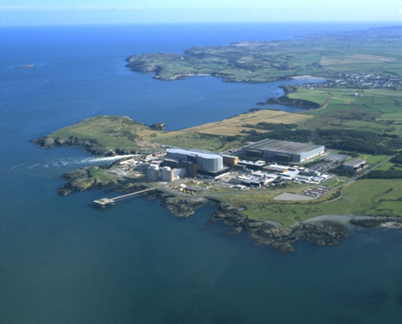
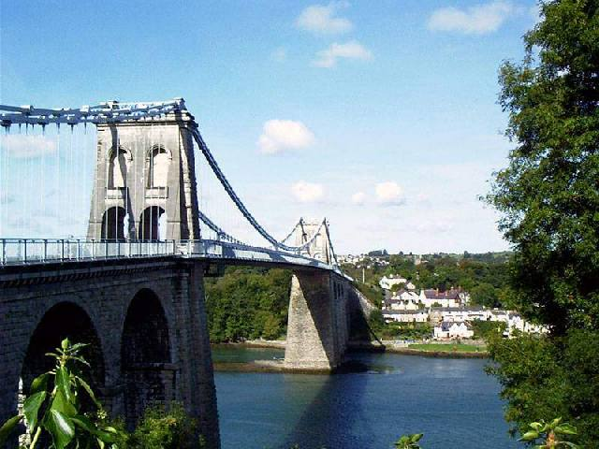
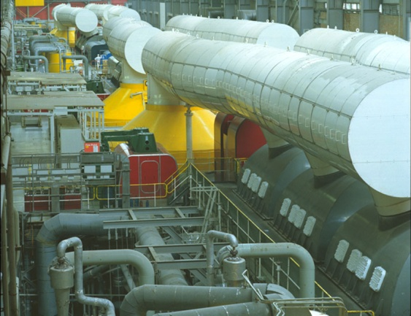
WELCOME TO WYLFA
Stuart Law – Site Director
Notes:
1

Slide 2
Geoff Vaughan Chairman Nuclear Industries Group
WELCOME

Slide 3
Farewell to Magnox
Wylfa Nuclear Power Station
28 October 2015
North Wales Network

Slide 4
A Long History
Magnox reactors were the first in the world to provide electricity to a national grid in 1956
From the 1950s through the 1960s the reactor design evolved
Initially steel pressure vessels, later concrete as gas pressures increased
The first reactor at Calder Hall produced 50 MWe
The last reactors, built here at Wylfa, produced 490 MWe when they started operation in 1971
They were built in England, Scotland and Wales
Two were exported, one each to Italy and Japan

Slide 5
Magnox Reactors in the UK
 | Number of Units | Production - MWe/unit | 1st Grid Connection
Steel | Pressure Vessel
Calder Hall | 4 | 50 | 1956
Chapelcross | 4 | 60 | 1959
Berkeley | 2 | 138 | 1962
Bradwell | 2 | 121 | 1962
Hunterston “A” | 2 | 180 | 1964
Hinkley Point “A | 2 | 235 | 1965
Trawsfynnydd | 2 | 195 | 1965
Dungeness “A” | 2 | 219 | 1966
Sizewell “A” | 2 | 210 | 1968
Concrete | Pressure Vessel
Oldbury | 2 | 217 | 1968
Wylfa | 2 | 490 | 1971

Slide 6
Something to Celebrate
For almost 60 years Magnox reactors
have provided electricity to the UK grid
without any major accident
and now the last reactor at Wylfa
is about to close
BUT , do not despair

Slide 7
The first entry when I googled “Magnox” was:
Magnox Reactor - 70% Off - Lowest Price On Magnox Reactor‎
www.stuccu.co.uk/Magnox/Deal‎ Free shipping, in stock. Buy now!‎
In stock‎ · Exclusive deals‎ · Compare prices‎
Has anyone told HORIZON?

Slide 8
Today’s Programme
13:30 | The historical background | Malcolm Grimston Senior Research Fellow, Centre for Environmental Policy, Imperial College
13:50 | Fuel manufacture & development | Bob Mckenzie Chief Technical Officer, Westinghouse
14:20 | Evolution of the Magnox design | Ted Hopper Principal Engineering Consultant, Magnox
15:00 | Break
15:30 | The Story of the Wylfa Boilers | Bob Clayton Magnox Nuclear Safety Committee
16:00 | Managing Magnox waste and spent fuel | Alun Ellis Science & Technology Director, Radioactive Waste Management Ltd, NDA
16:30 | Wylfa Newydd, project overview Advanced Boiling Water Reactor | Jacob Home Operations Engineer, Horizon Steven Hall Hitachi-GE
17:00 | Close

